Slide 1
Central and Peripheral Nervous System

Slide 2
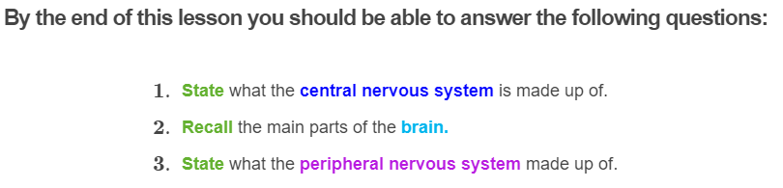
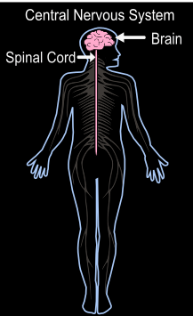
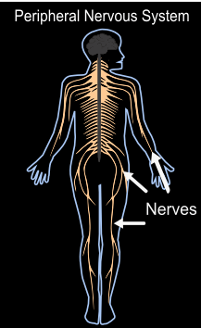

Slide 3
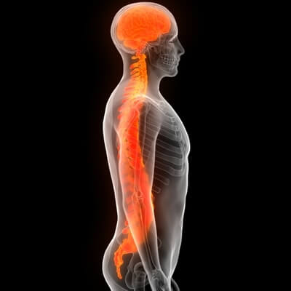
The central nervous system (CNS) consists of the brain and the spinal cord.
The central nervous system is the control centre that processes all the information it receives from your sensory neurons about the environment, and decides whether it should make a response or do nothing.
The central nervous system is like the big boss. It makes all the important decisions and ensures that all your body systems are functioning.

Slide 4
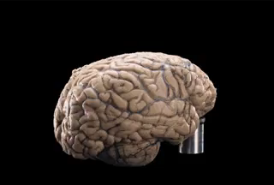
The Brain
The brain controls all parts of your body and is responsible for thinking, movement, learning, memory, and maintaining homeostasis. It is the most important organ in your body. Without it you cannot survive!
Our brains are made up of lots of brain cells, but only 10 percent of these brain cells are neurons. The rest of the brain cells are there to provide support for the neurons to keep them well nourished.

Slide 5
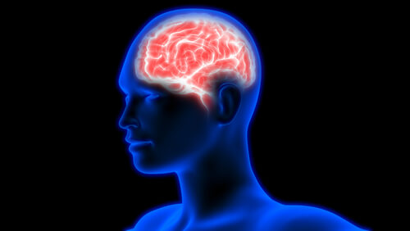
Cerebrum
The brain is made up of many different parts that all work together and perform many different functions. Let's have a look at some of the different parts of the brain!
The cerebrum is the largest part of your brain and makes up around 90 percent of your whole brain.
It's no wonder that the cerebrum is responsible for a lot of functions considering its size! It is responsible for functions like thinking, memory, speaking, learning, and voluntary movements (actions that you control when thinking about them).

Slide 6
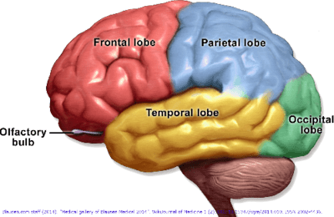
Cerebrum II
The cerebrum is made up of four primary areas, called lobes. Each of these lobes are associated with a different function.

Slide 7
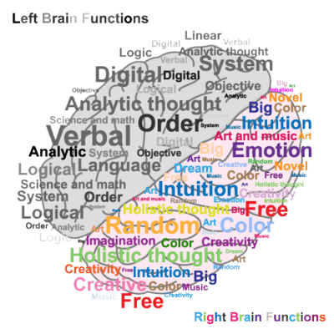
Cerebrum: the two hemispheres
The cerebrum can be divided up into two main parts, called hemispheres.
The left hemisphere (the left side of the brain), controls the right side of your body. On the other hand, the right hemisphere (the right side of the brain) controls the left side of your body.
The left side of the hemisphere is said to be involved in more logical thinking, helping you with things like maths, speech, science. The right hemisphere is said to be involed in more creative activities like art, and music.
Although each of these hemispheres handle different tasks, both work together and communicate with each other.

Slide 8
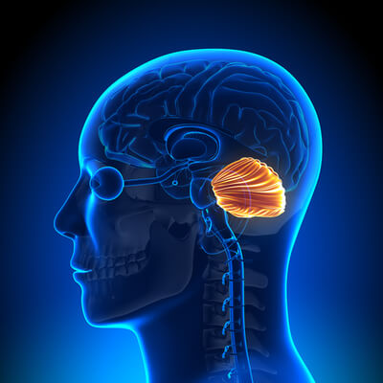
Cerebellum
If you slide your fingers down the back of your head, you may be able to feel the point where your skull curves inwards! This is where your cerebellum is located.
Although it only takes up about 10 percent of your brain’s volume, the cerebellum contains over half of all of your brain’s neurons.
It is a very important part of your brain, and is responsible for controlling your coordination, balance and movement. Without it, simple tasks, such as walking, would be impossible!

Slide 9
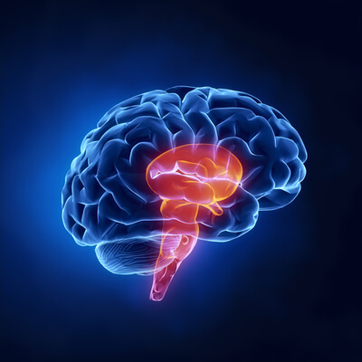
Brain stem
At the bottom of the brain you will find the brain stem! The brain stem connects the rest of your brain to the spinal cord.
The brain stem is involved in involuntary body functions - functions that you do not control through conscious thinking. This includes important processes, such as breathing, keeping your heart beating, maintaining blood pressure, and coordinating important reflexes.

Slide 10
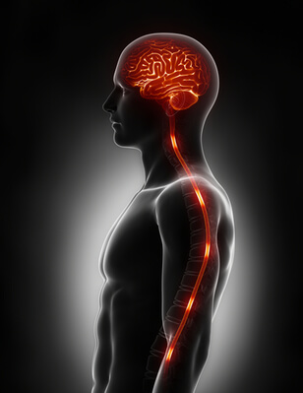
The spinal cord
The spinal cord is a long tubelike structure found inside the spinal column (bones that surround and protect the spinal cord) and is connected to the end of the brain stem.
The main function of the spinal cord is to connect the brain to the peripheral nervous system, which is made up of all the nerves in your body. These nerves are all connected to, and branch out from the spinal cord.
This means that the spinal cord acts as the main pathway for the brain to send information to the rest of the body. Without the spinal cord, the brain would not be able to communicate with the rest of the body.

Slide 11
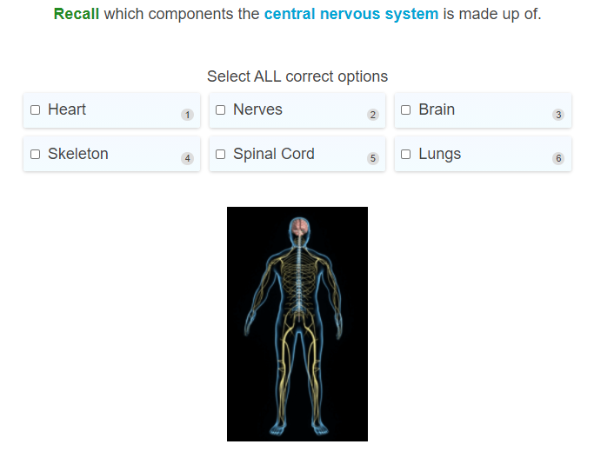

Slide 12
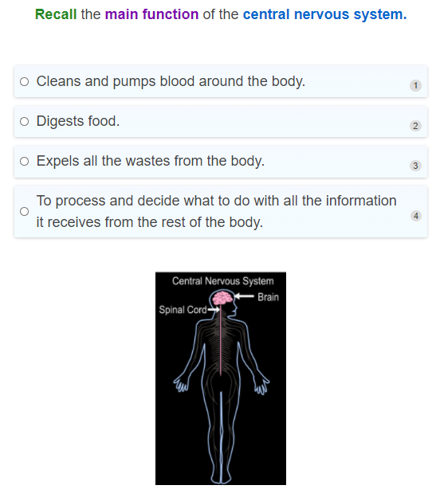

Slide 13
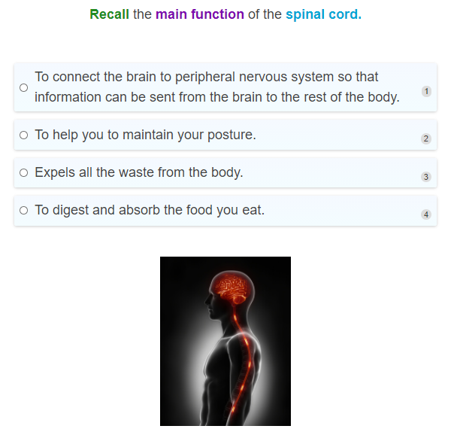

Slide 14
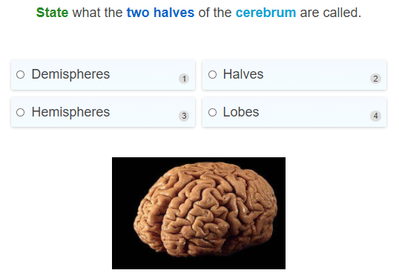

Slide 15
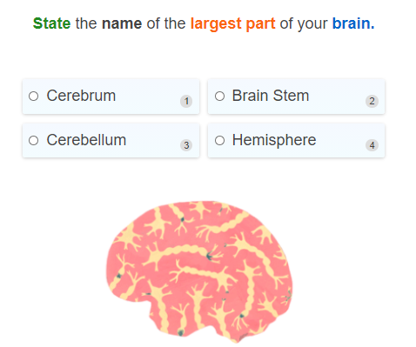

Slide 16
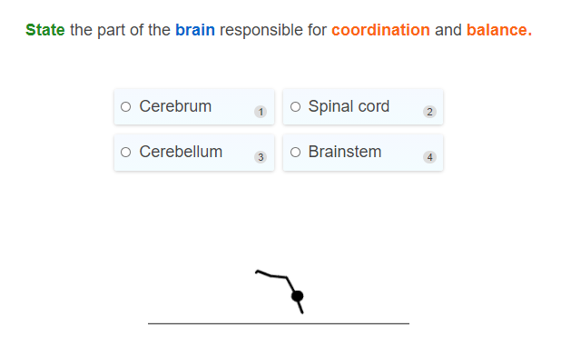

Slide 17
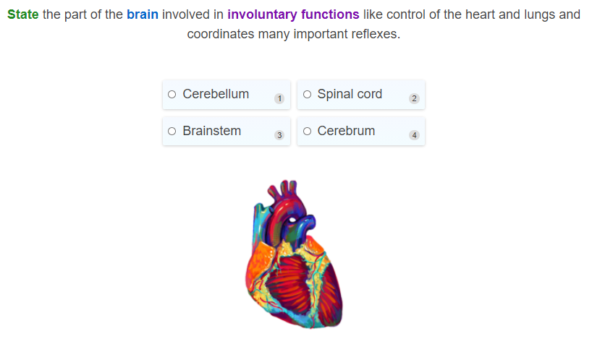

Slide 18
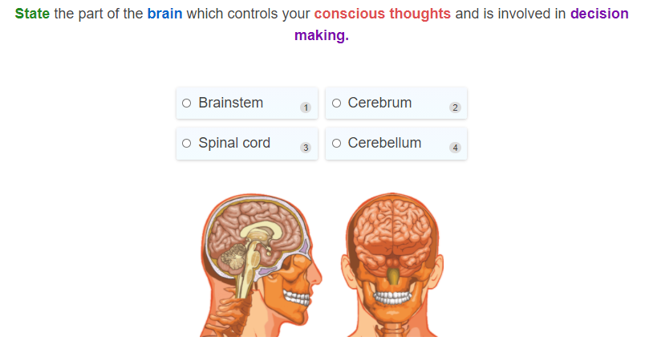

Slide 19
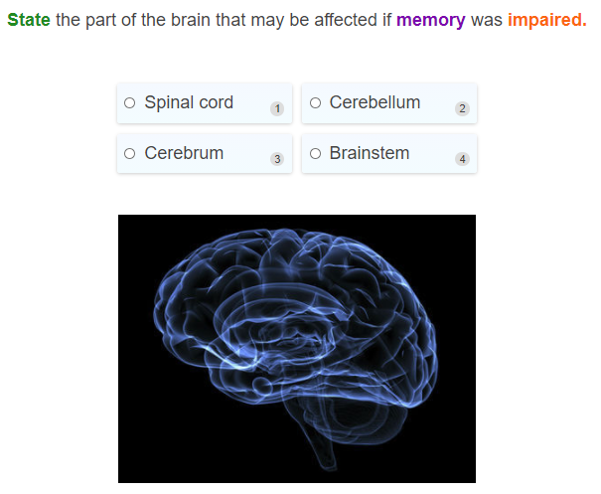

Slide 20
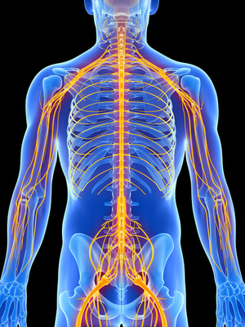
The Peripheral Nervous System (PNS) is made up of all the nerves in the body.
Each nerve consists of many neurons.
The peripheral nervous system can be divided into two separate parts:
1. | Somatic nervous system
2. | Autonomic nervous system

Slide 21
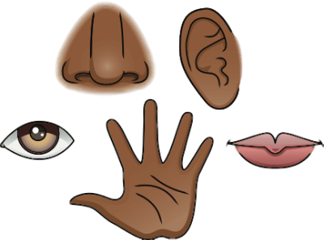
The somatic nervous system is the part of the peripheral nervous system responsible for all voluntary movements.
It consists of all the sensory and motor nerves that are connected to your voluntary (skeletal) muscles. These are the muscles that move when you want them to.
Its main function is to collect information through sensory organs such as the eyes, ears and mouth and send it up to the central nervous system to produce movement of your muscles!

Slide 22
Your somatic nervous system in action
If you feel a spider walking over your hand, this information will be sensed by sensory receptors in your skin and electrical signals will get sent through your sensory neurons to the central nervous system.
A motor neuron then takes information directly from the central nervous system to the muscles to produce movement.
This is an example of your somatic nervous system in action!

Slide 23
The somatic nervous system is also responsible for reflexes that involve your voluntary muscles.
Reflexes are movements that do not require input and processing from the brain to perform.
For example, if you accidentally put your hand on a hot element, you would automatically remove it, without even thinking about it!

Slide 24
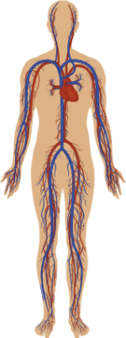
The autonomic nervous system
The autonomic nervous system is involved in involuntary and unconscious actions, like how your pupils can change size in response to light, and your heart beating. You can think of the autonomic nervous system as being automatic! You don't have to think about them, they just happen.
Essential bodily functions such as breathing, digestion, heart rate, and urination are regulated by the autonomic nervous system.

Slide 25

The autonomic nervous system can be divided up into two parts, the sympathetic and the parasympathetic systems.
These systems both work involuntarily, but have opposite effects on effectors (the organs and glands) to each other.
The sympathetic nervous system activates a fight or flight response and usually occurs when you are under stress, and prepares your body for things like running away when you see a hoard of wasps chasing after you.

Slide 26

Parasympathetic nervous system: The rest and digest response
On the other hand, the parasympathetic nervous system activates a rest and digest response. This means it helps you to conserve energy, relax and brings your heart rate down after running away from those wasps!

Slide 27
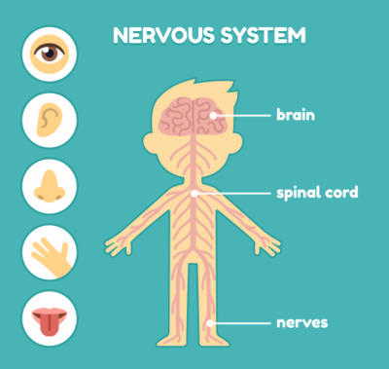
The central and the peripheral nervous systems work together and are always communicating with each other to keep your body working!
The peripheral nervous system, which is made up of all the nerves in your body, is constantly receiving information about other areas inside your body or about the environment through your sensory organs.

Slide 28


Since your peripheral nervous system is connected to the central nervous system through the spinal cord, which in turn connects to the brain, our brain can then process this information and then decide on an appropriate response.
Sometimes this response is voluntary, for example if you decide to get up and go for a walk.
Other times it may be involuntary, like when you step outside and the sun is too bright, your pupils automatically contract.

Slide 29
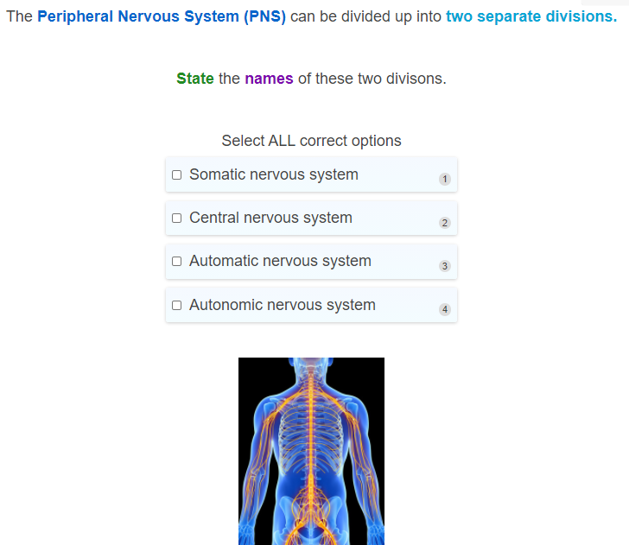

Slide 30
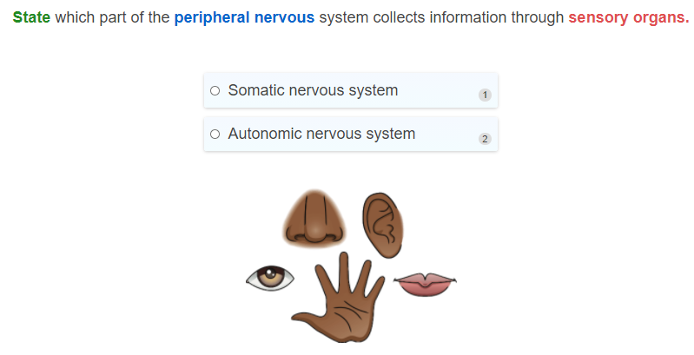

Slide 31
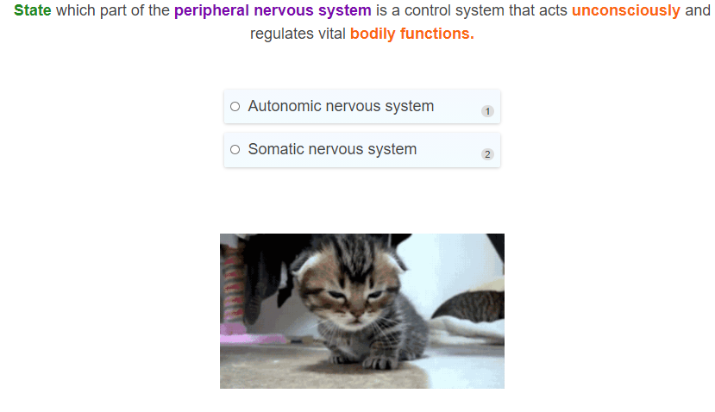

Slide 32
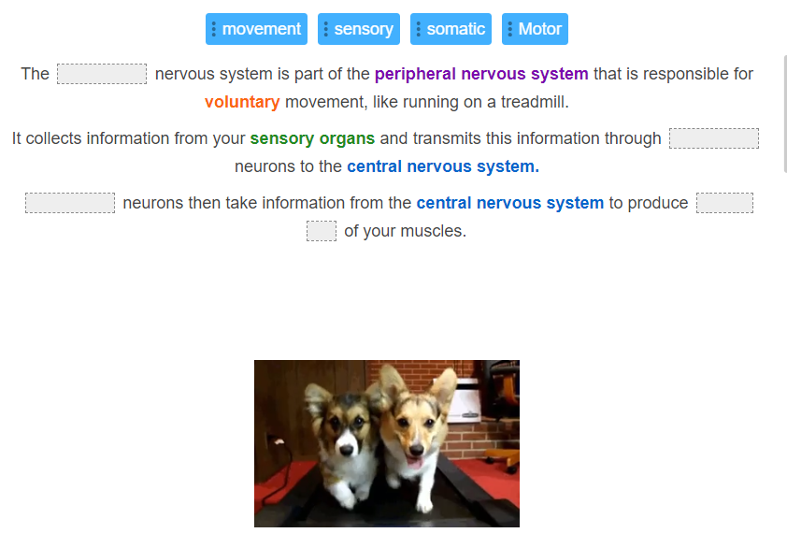

Slide 33
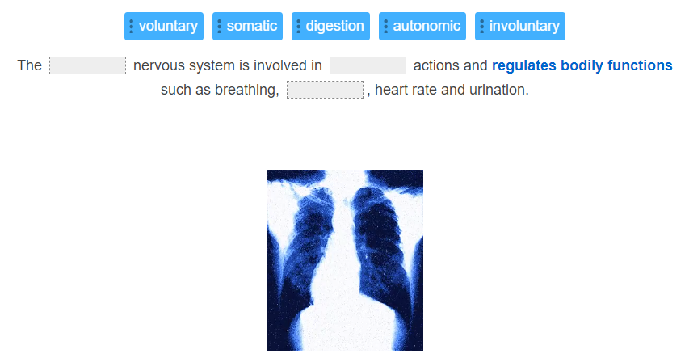

Slide 34
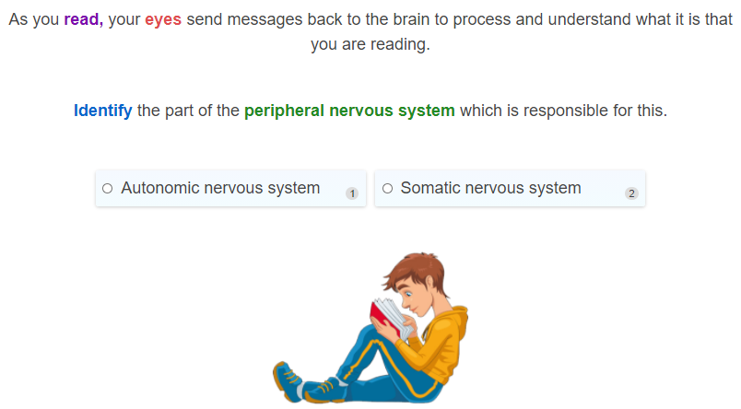

Slide 35
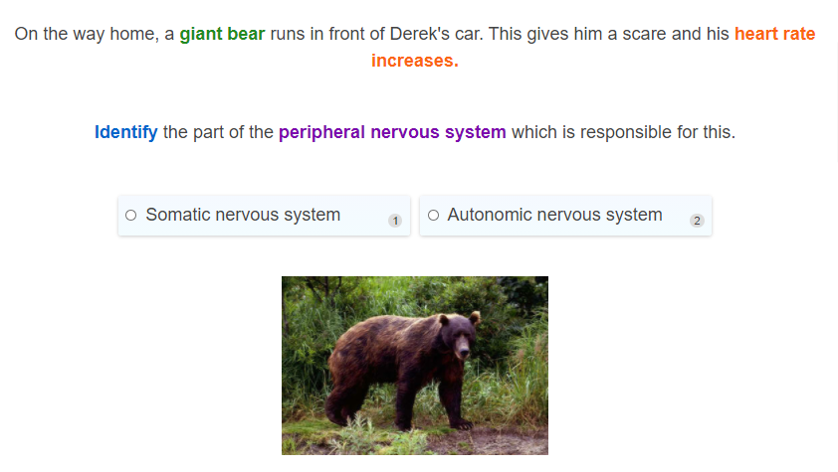

Slide 36
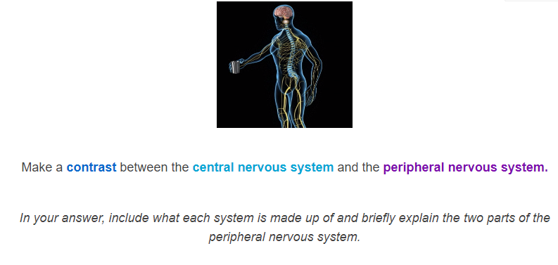

Slide 37
